Slide 1
SURVEYING INTERNET TRAFFIC ACROSS FREQUENTED WEBSITES
By: Arya Shryock, Alex Christensen, Miranda Manning, and Yibarek Tadesse

Slide 2
OBJECTIVE
Analyze how websites are implemented and operate differently from one another
Using Wireshark, a network protocol tracker, as a means to collect and store network traffic data from various frequented internet sites such as Wikipedia or Best Buy
Traffic data is then filtered for relevant info (e.g. packet count) to then be fit for model training
Can then predict the website source of data with the use of model training with: KNN, ridge classifier, and gradient booster

Slide 3

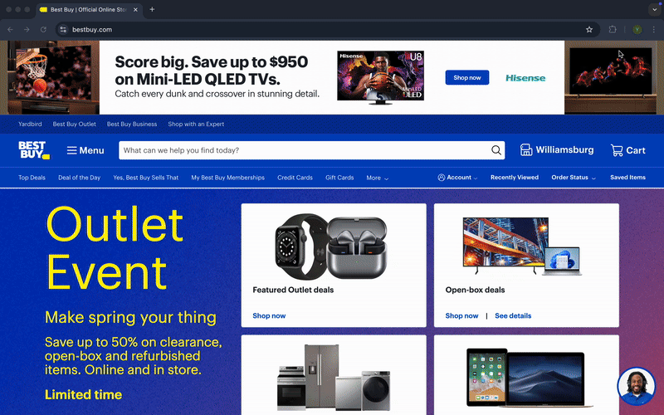
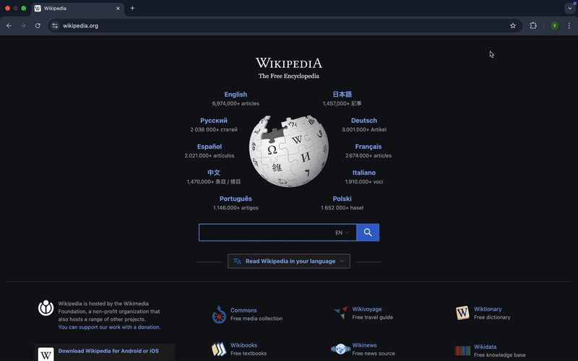
DATA COLLECTION

Slide 4


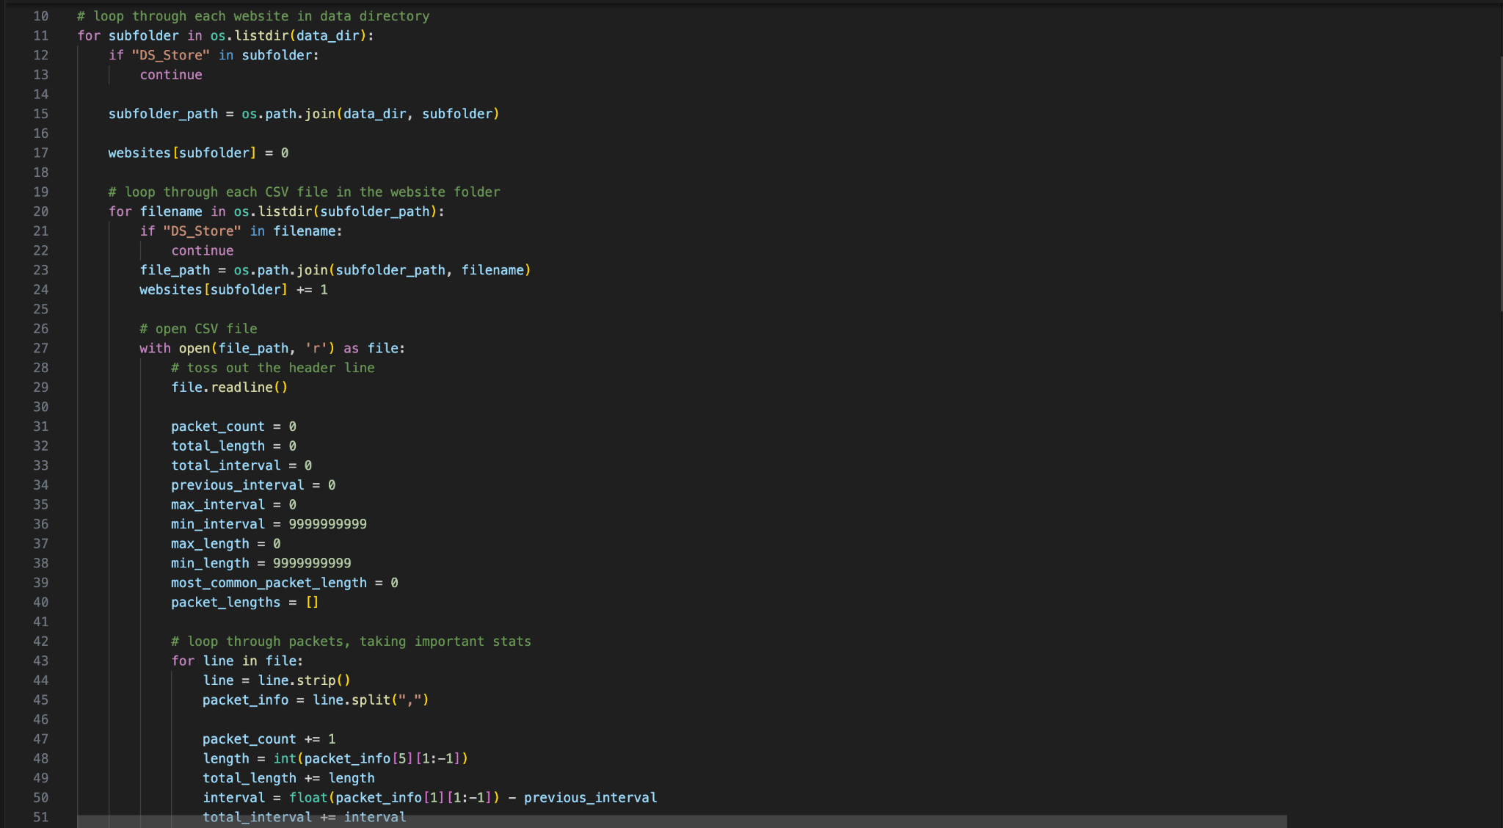
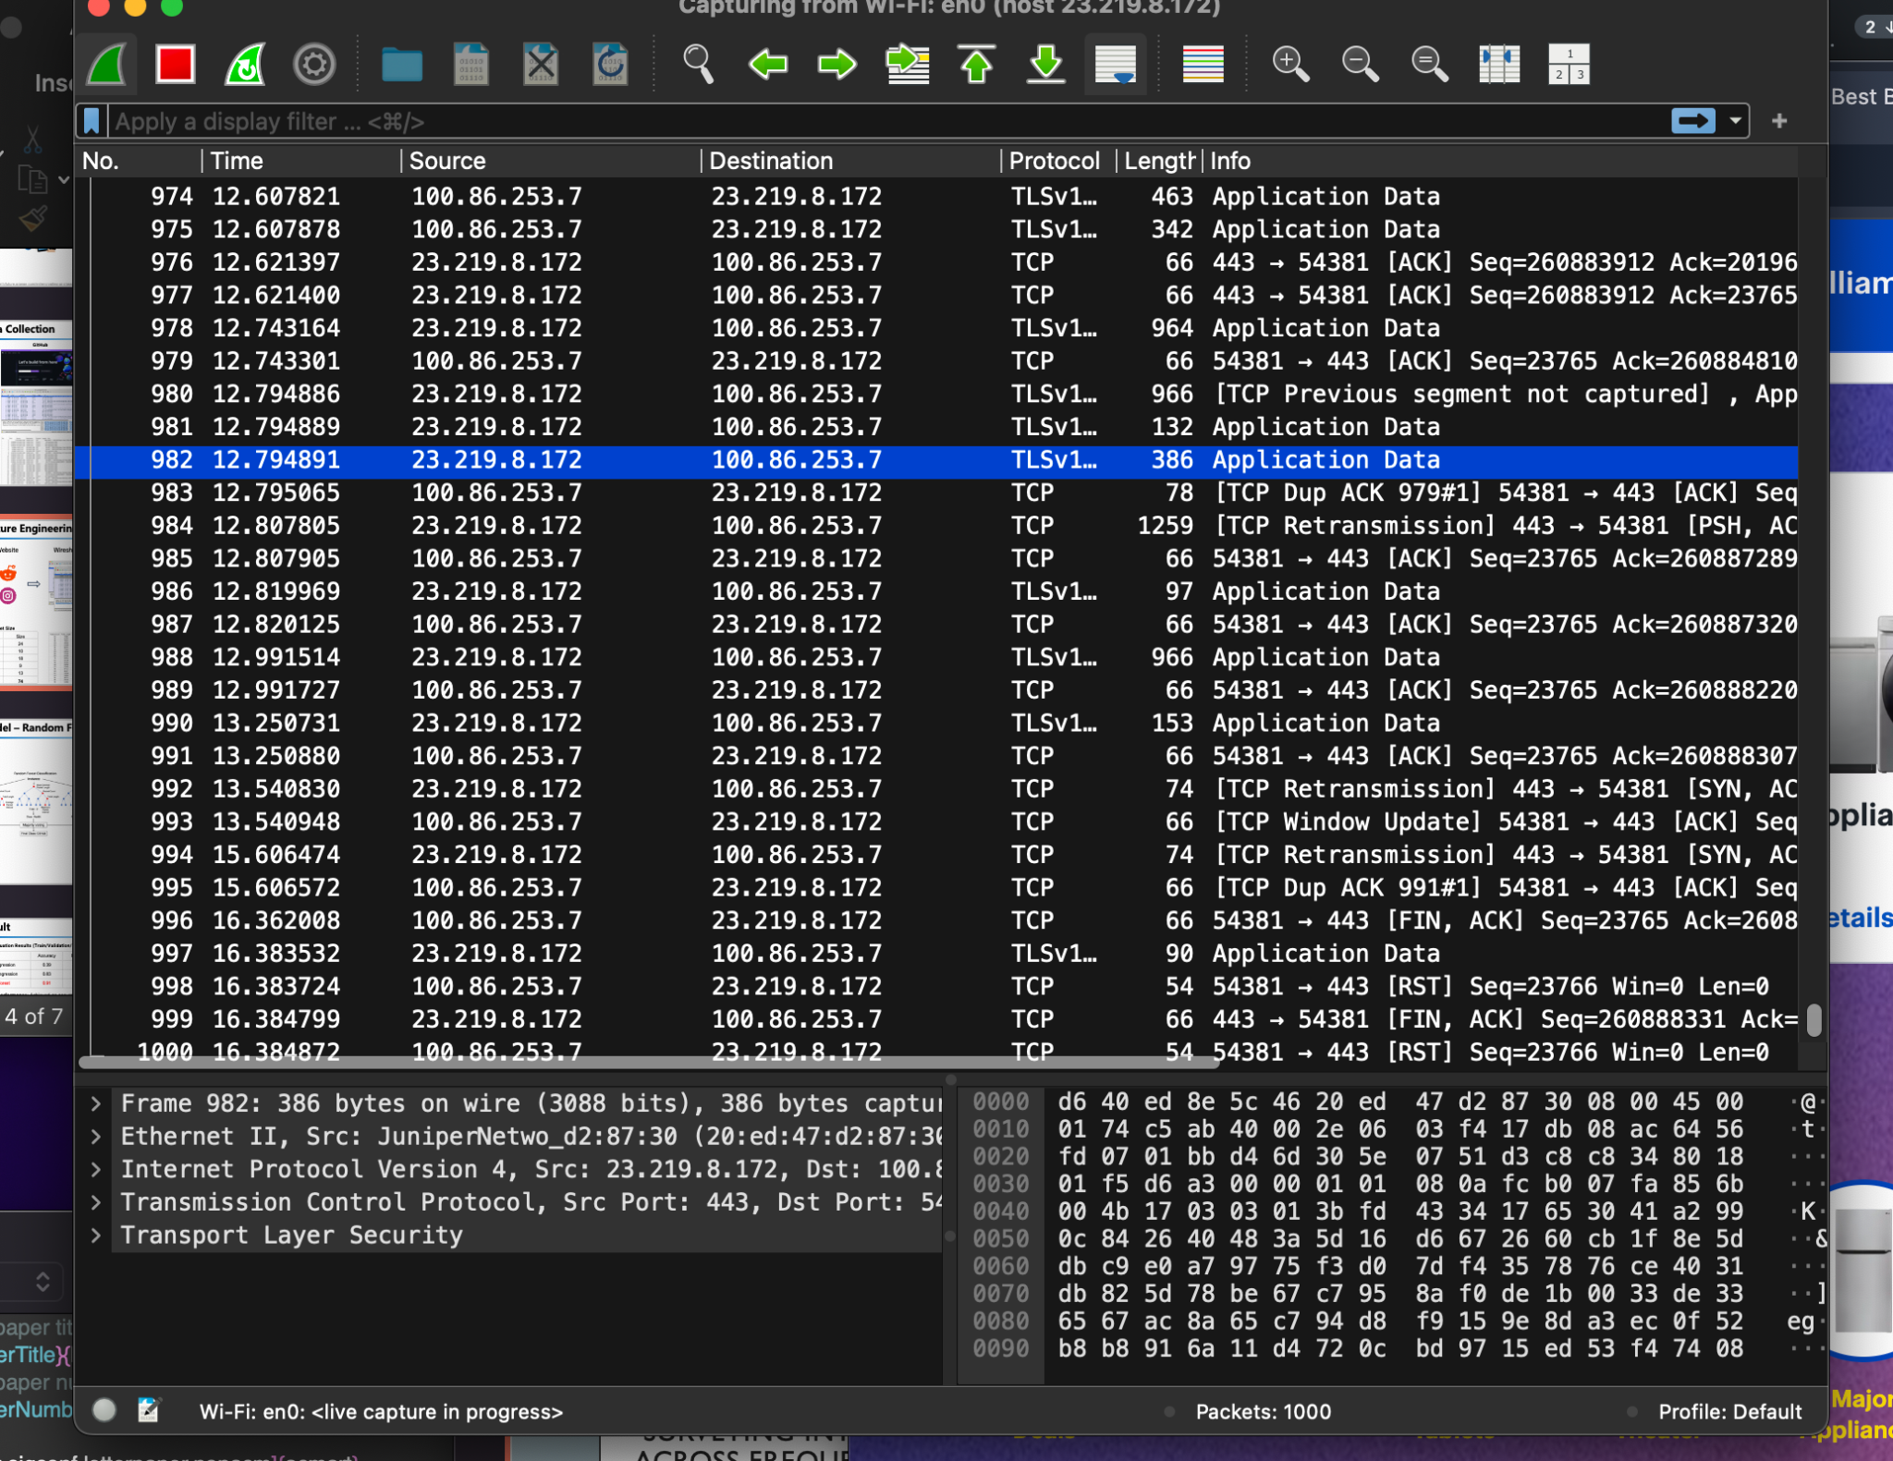



FEATURE ENGINEERING

Slide 5
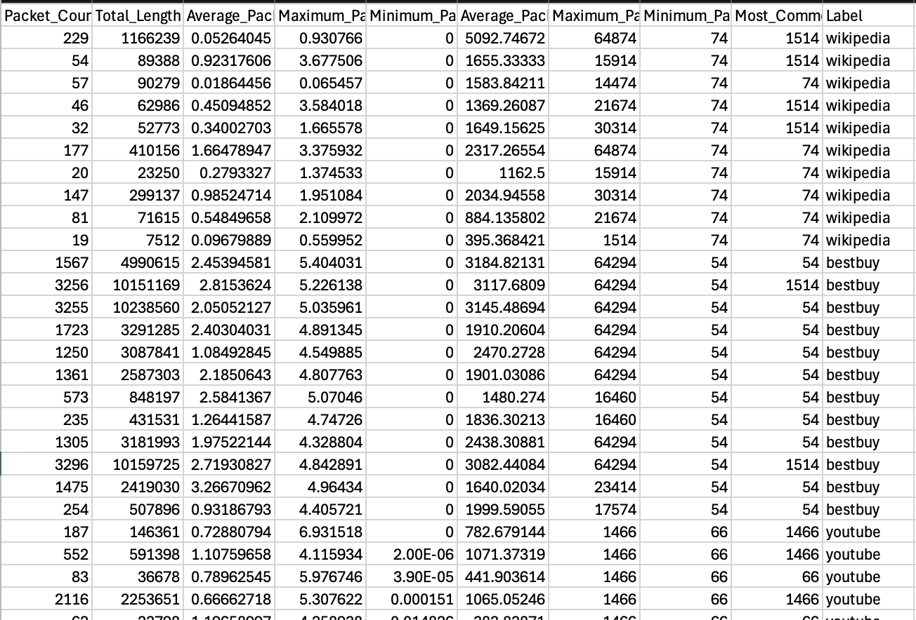
Sample Data

Slide 6
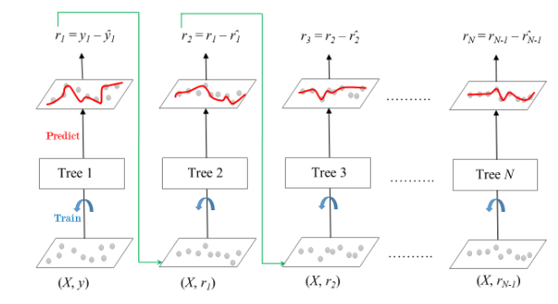
MODEL - Gradient Boosting Classifier
Definition: A learning model that sequentially trains weak decision trees to minimize the loss function of the previous tree, eventually summing the contributions of all trees to come to a consensus decision.
Initialization:
Tree is initially trained using the true labels and data from the training sets supplied
Shrinkage:
Each subsequent tree is scaled by a factor called learning rate, which reduces the contributions of each tree to control overfitting
Convergence:
Model iterates until an arbitrary number of trees have been trained, or the loss function is fully optimized (residuals sum near to 0)
Model Parameters
Learning Rate: 0.1, Loss function: logarithmic, n_estimators: 100

Slide 7
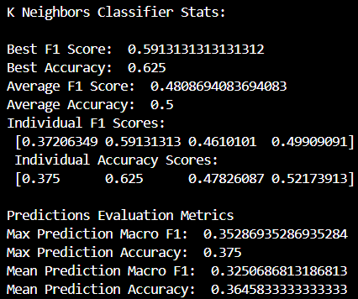
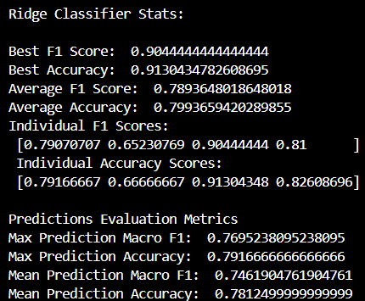
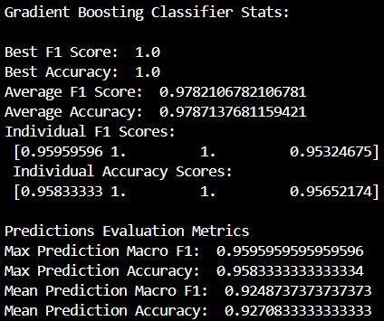
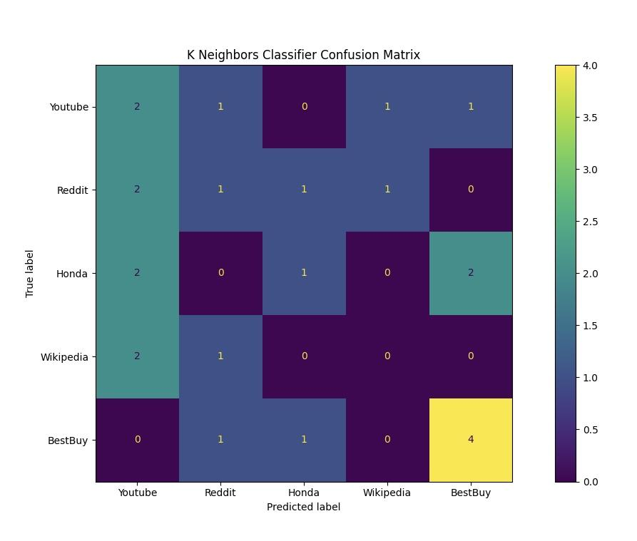
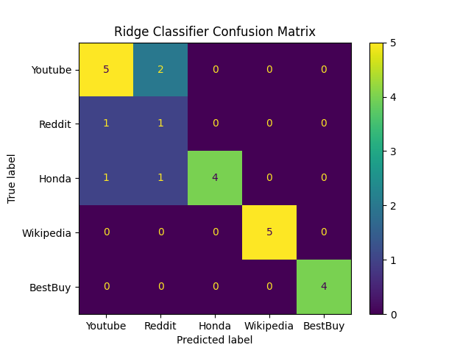
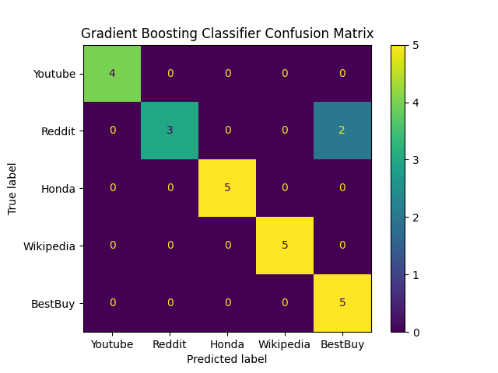
RESULTS

Slide 8
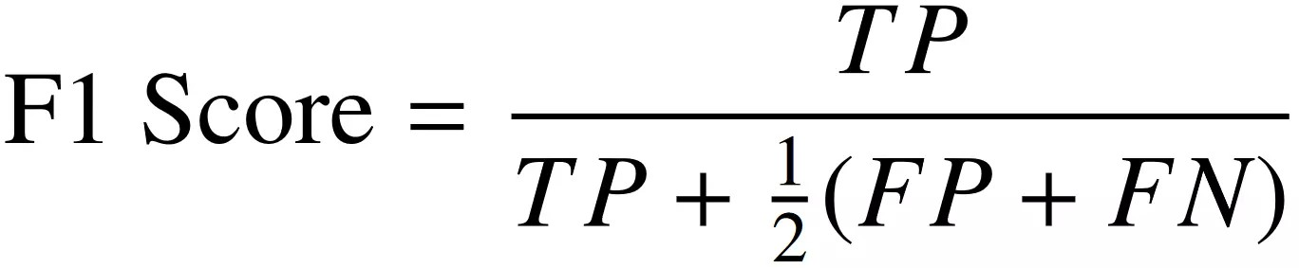
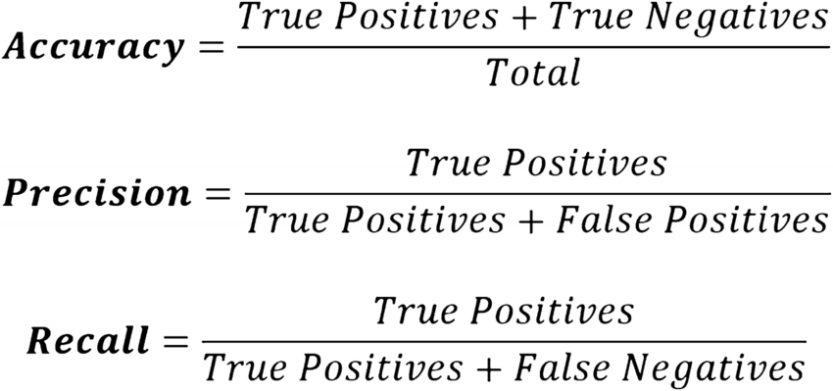
RESULTS INTERPRETATION
 | K Nearest Neighbors | Ridge | Gradient Boosting
Average F1 score | 0.409 | 0.7894 | 0.9782
Average accuracy | 0.5 | 0.7994 | 0.9787

Slide 9
References
1.11. Ensembles: Gradient boosting, random forests, bagging, voting, stacking. (n.d.). Scikit-learn.
https://scikit-learn.org/stable/modules/ensemble.html
GeeksforGeeks. (2025, March 11). Gradient boosting in ML. GeeksforGeeks.
https://www.geeksforgeeks.org/ml-gradient-boosting/
Minhas, M. S. (2025, March 5). Gradient descent unraveled. Towards Data Science.
https://towardsdatascience.com/gradient-descent-unraveled-3274c895d12d-2/
Natekin, A., & Knoll, A. (2013). Gradient boosting machines, a tutorial. Frontiers in Neurorobotics, 7. https://doi.org/10.3389/fnbot.2013.00021
Salau, A. O., & Beyene, M. M. (2024). Software defined networking based network traffic classification using machine learning techniques. Scientific Reports, 14(1).
https://doi.org/10.1038/s41598-024-70983-6

Slide 10
Thank You!

